Slide 1
Hire Heroes USA
Effects of Donor Location and Fundraising Campaigns on Donation Amounts

Slide 2
Problem and Motivation:
Hire Heroes USA, is an organization with a mission to “empower U.S. active military, veterans, and spouses to succeed in the civilian workforce.”
Information:
Current Growth - $9.4M to $9.7M
Want to know:
How geography relates to donor behavior
Which locations to target for fundraising
Provided:
Data Tables
Data Dictionary

Slide 3
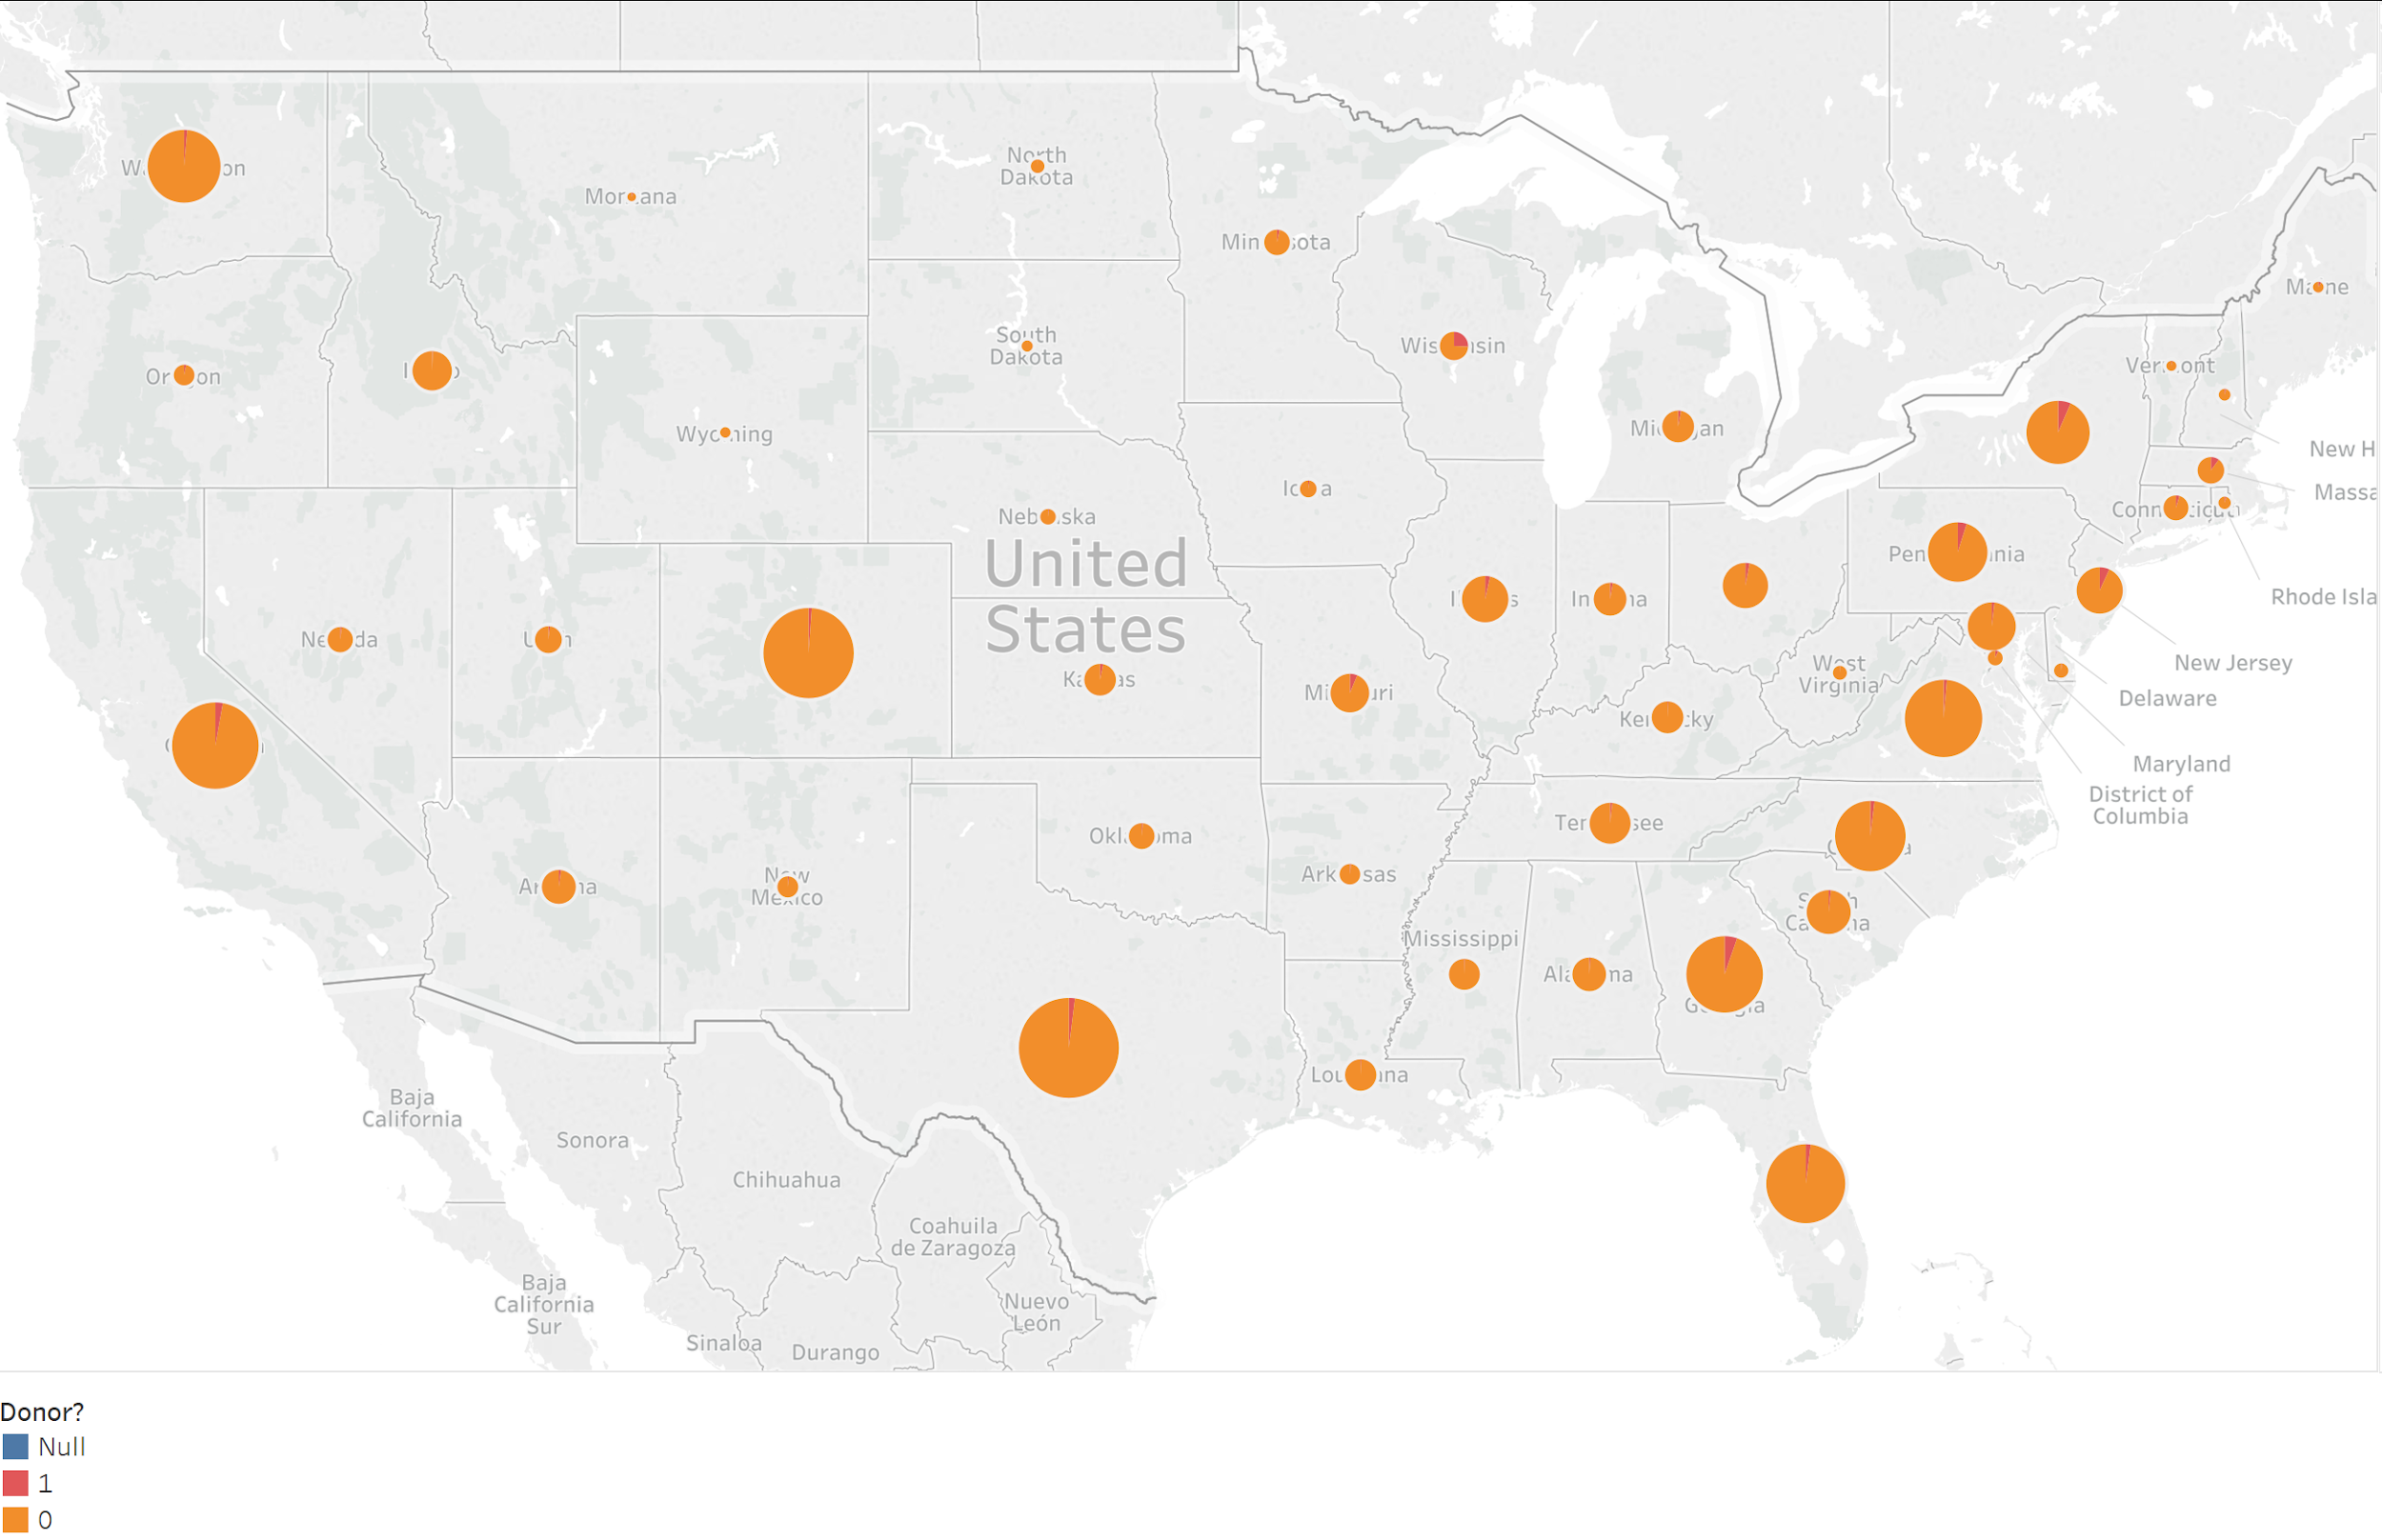

Problem and Motivation:
Current Growth - $9.4M to $9.7M
Want to know:
How geography relates to donor behavior
Which locations to target for fundraising
Provided:
Data Tables
Data Dictionary
Notes:
As illustrated in this graph, we found that donor rates were exceptionally low in almost every state. The size of the bubble represents the total number of members and the red slice represents the proportion of these members who are donors.

Slide 4
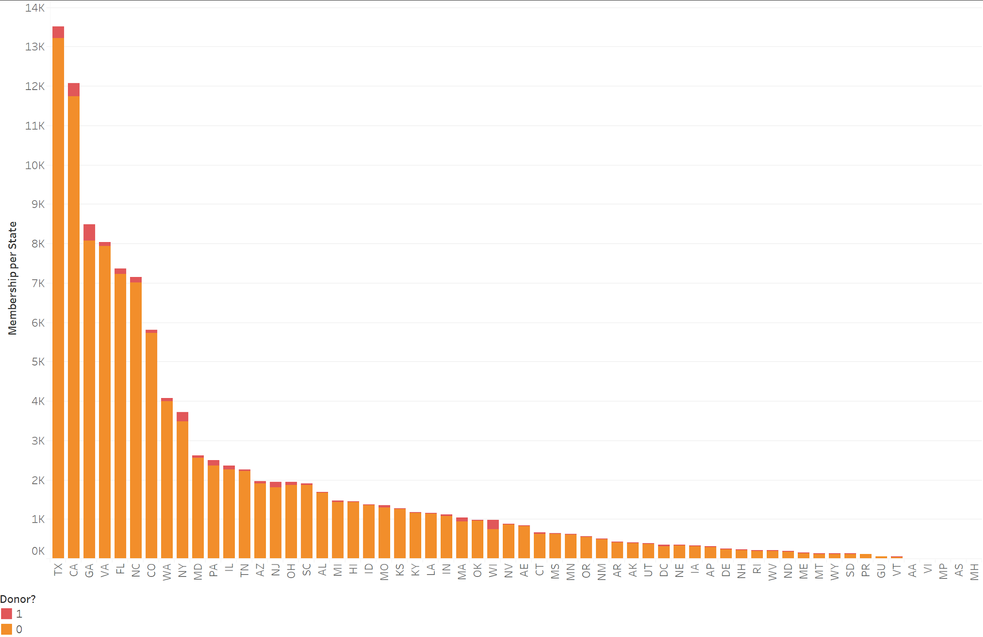
Approach:
Select A Business Question
Understand the Business and the Data
Review Provided Data Tables and Dictionary
Clean and Prepare the Data
Model the Data for Further Analysis
Make Suggestions on Future Actions
Notes:
To reiterate how poor the donor rate is, we prepared an additional visualization to further drive home the rate of donation.

Slide 5
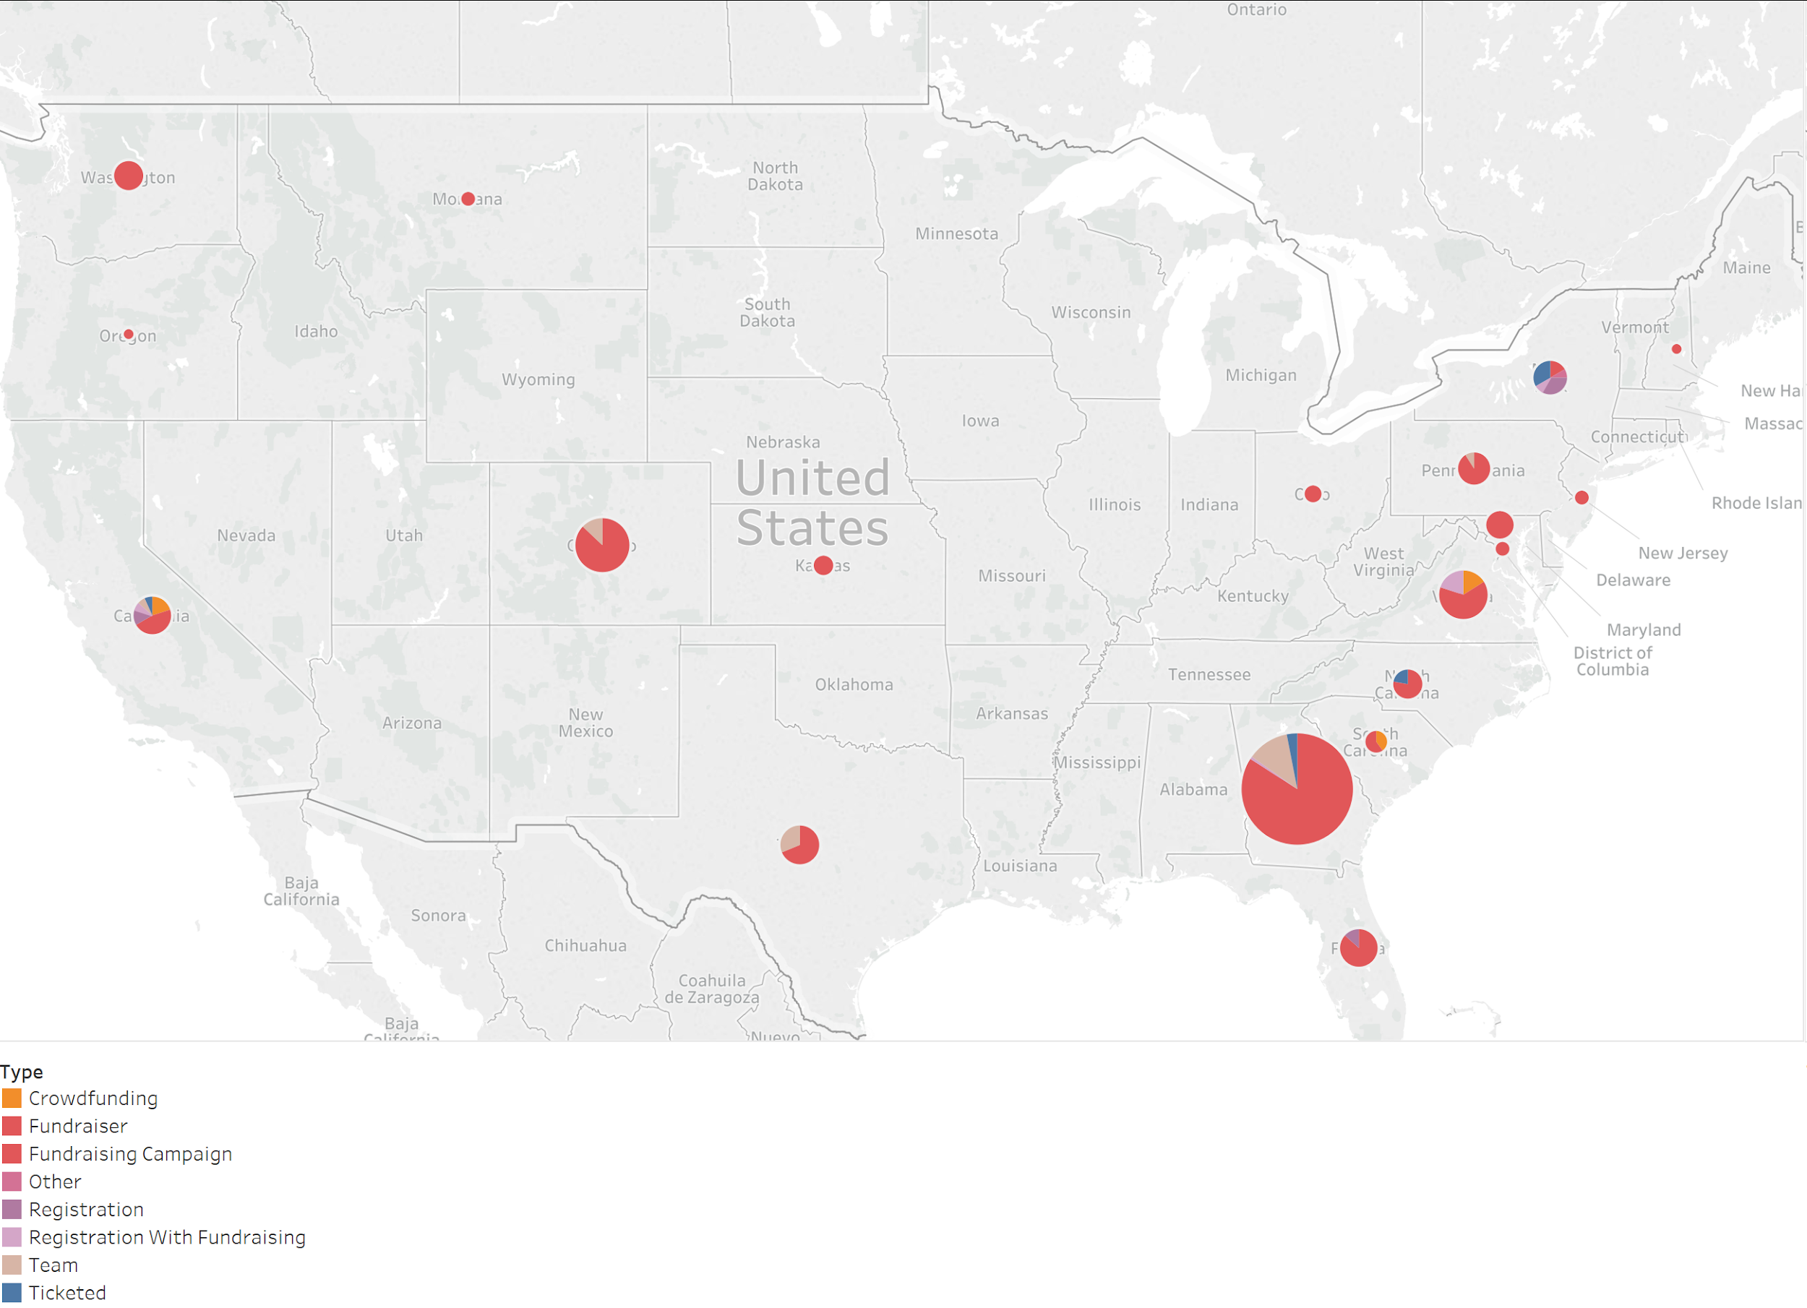
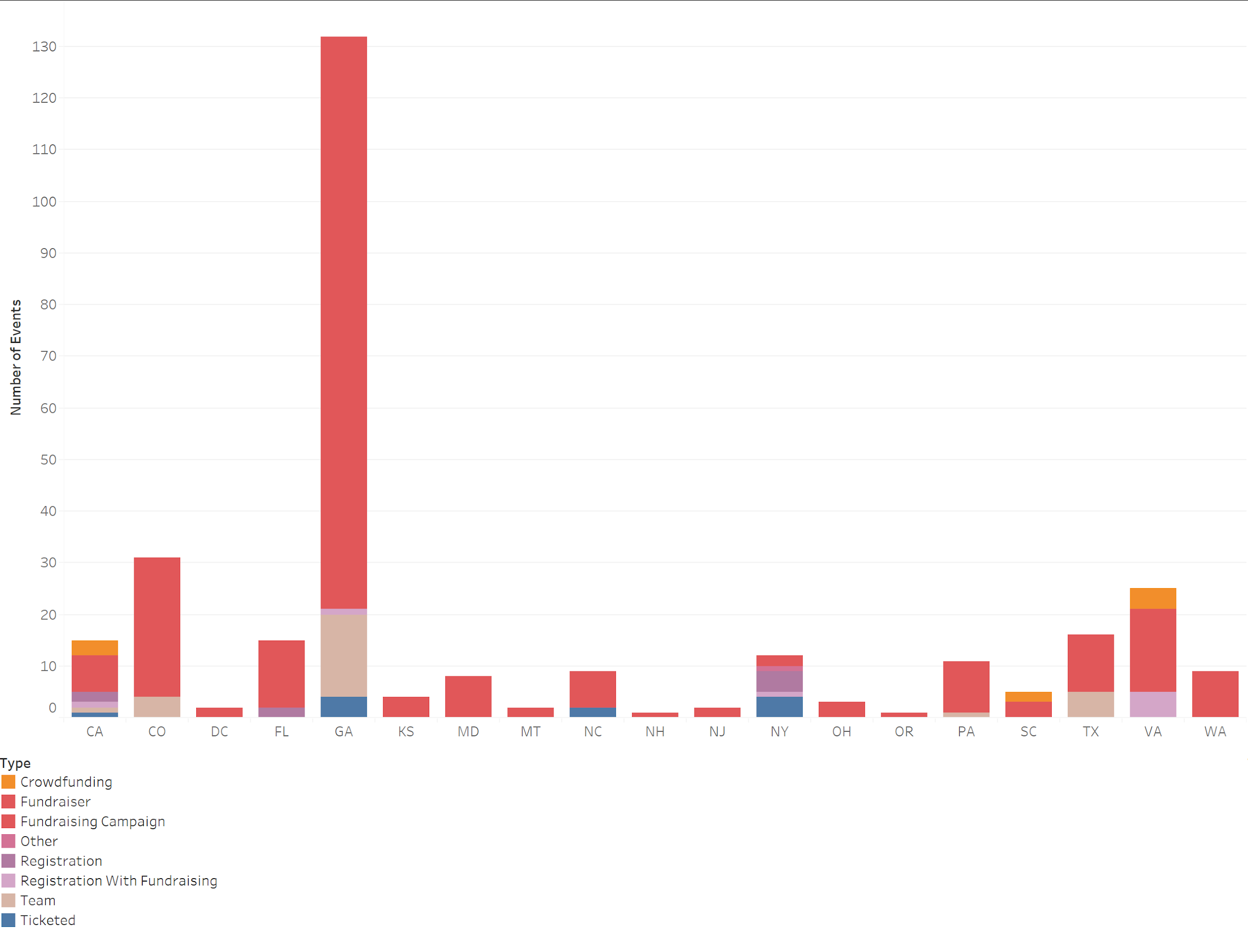
Datasets:
Provided by Hire Heroes USA
Additional Zip Codes from a free government database.
Notes:
Using the datasets, we were able to geographically map the events held by the company. The number of events is indicated by the size and the type of event is shown by the area of the pie chart. Although this doesn’t mean much right now, it will make more sense when each type is explained. As you can clearly see, Fundraisers make up the majority of the events held. To alternatively represent this, each state that holds an event is listed in the second graph.

Slide 6
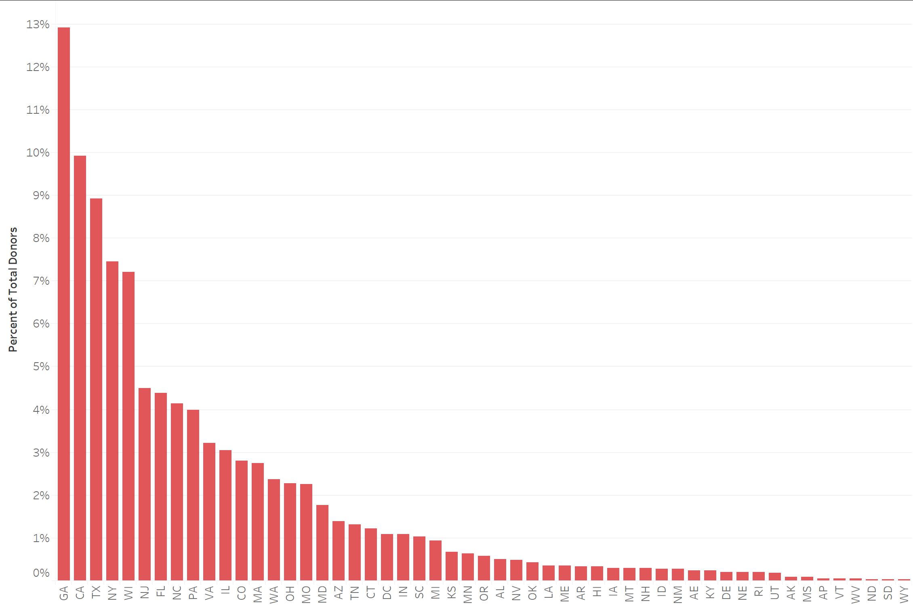
Tools and Analytics:
Tools:
Microsoft Excel
Tableau Prep
Tableau Desc
Analytics
Visualizations
Comparisons
Validation
Notes:
Don’t talk about graph, it’s just an example of what we created with the tools.

Slide 7
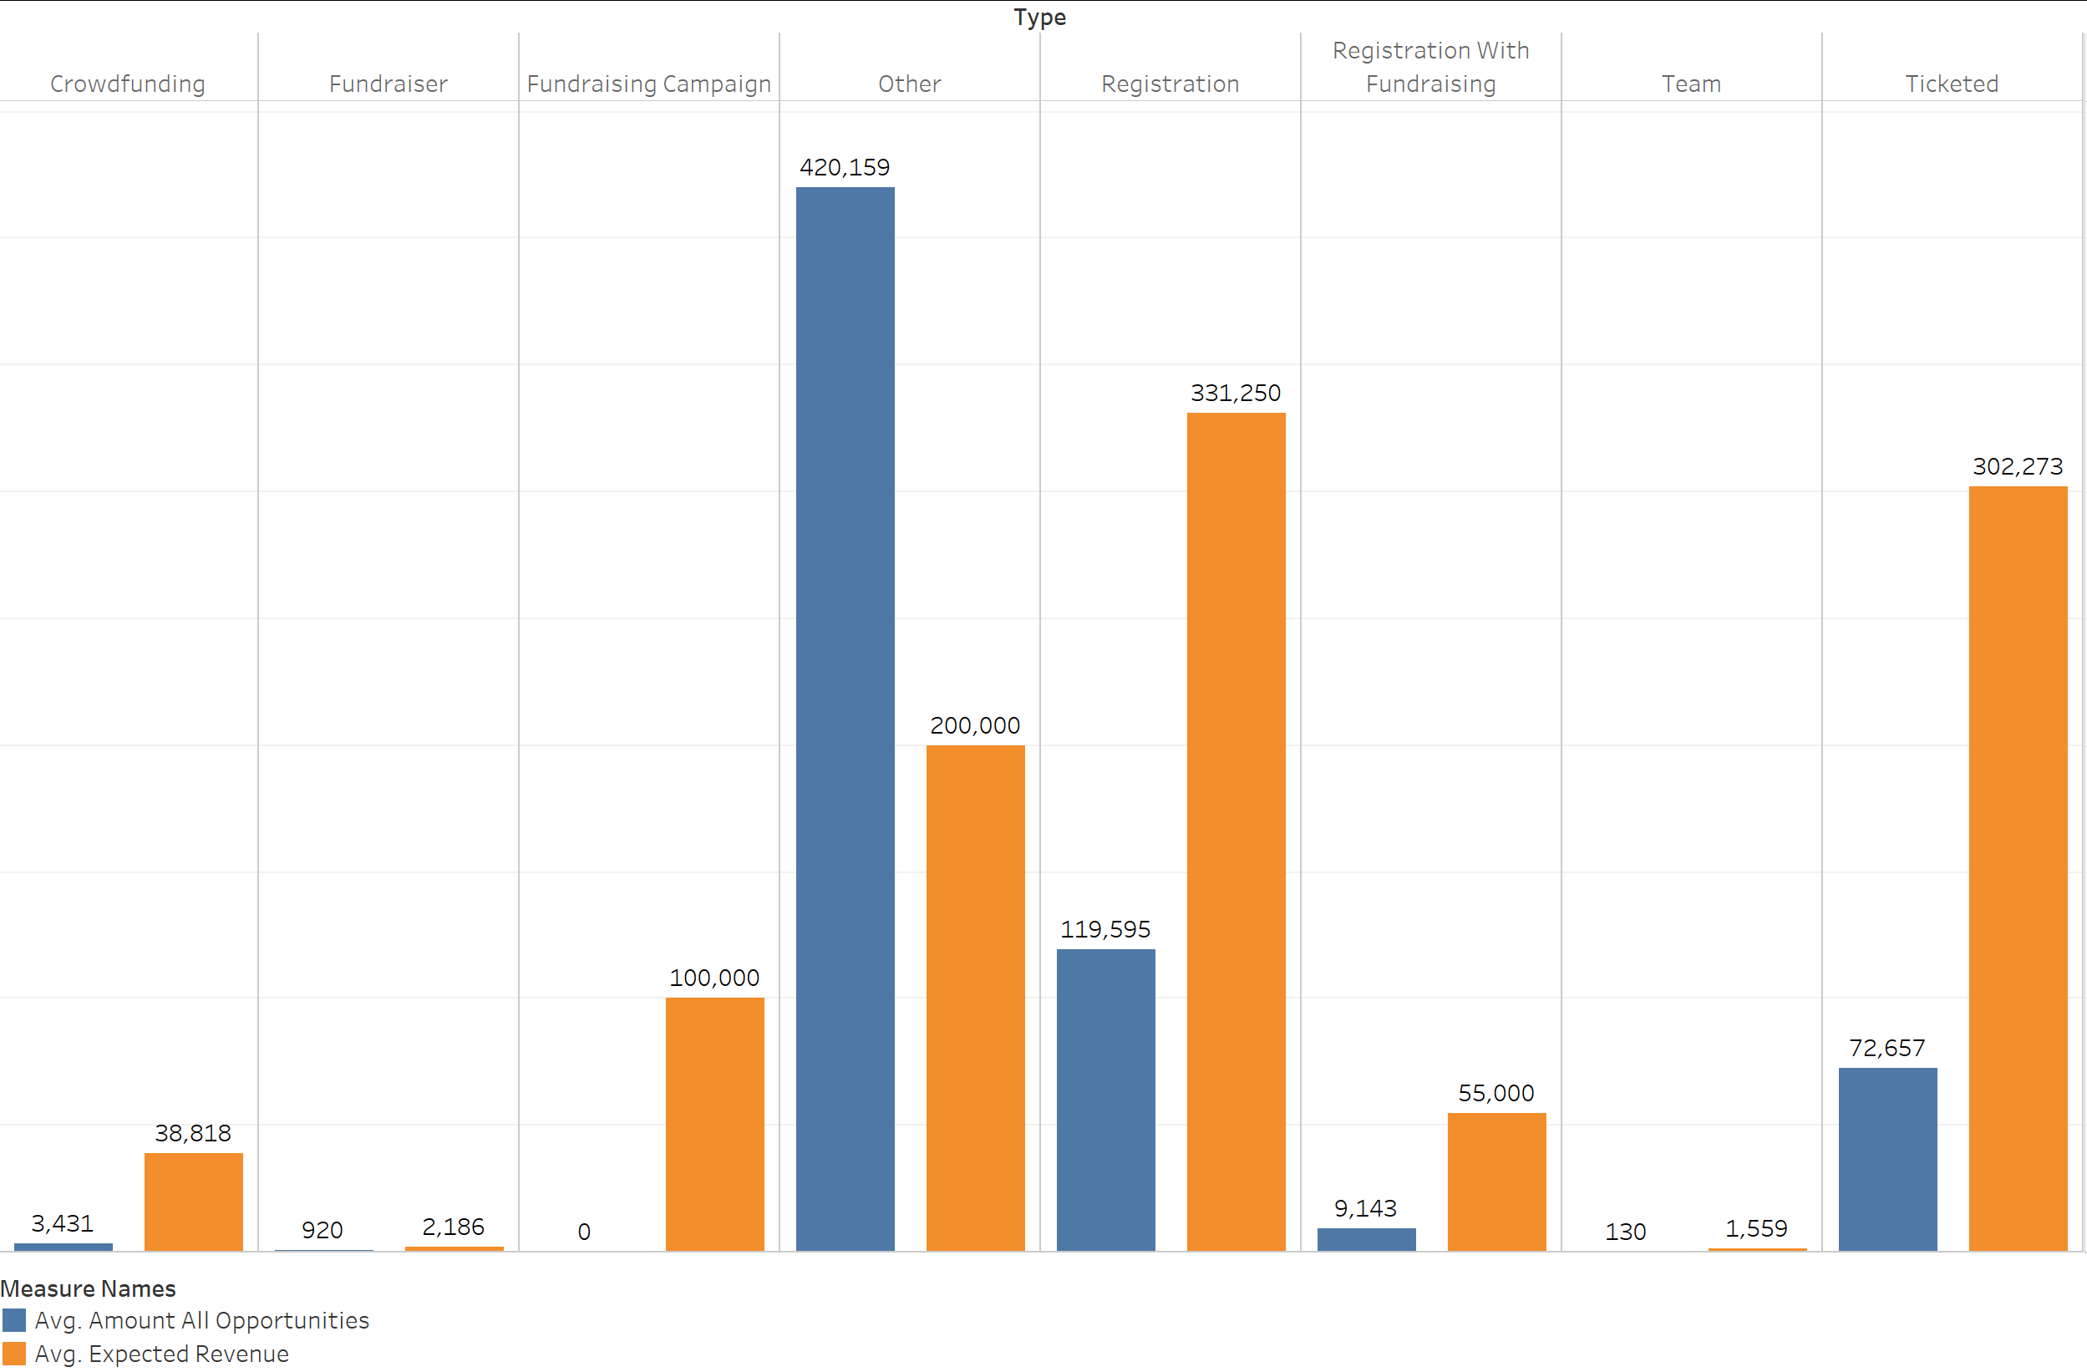
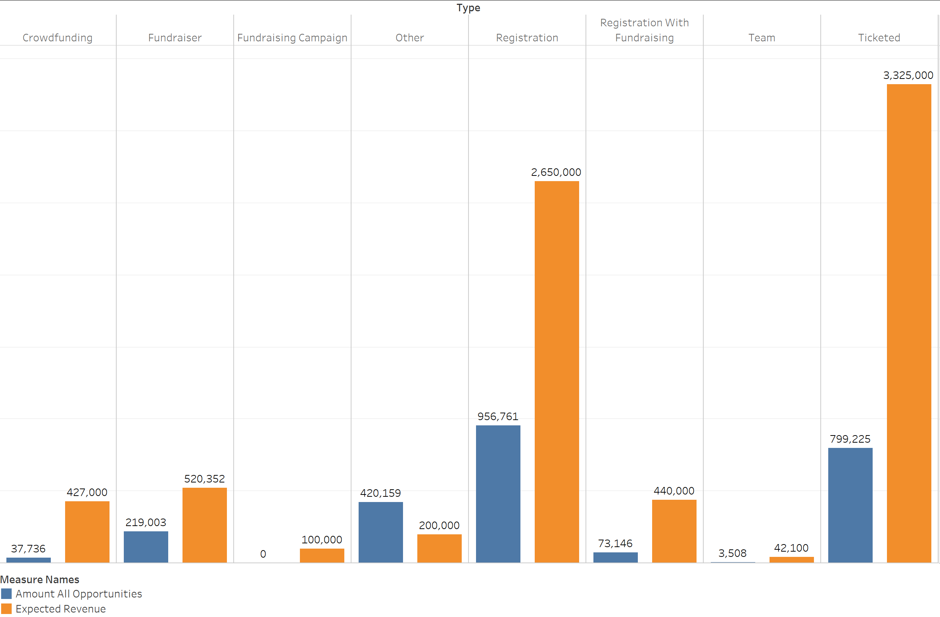
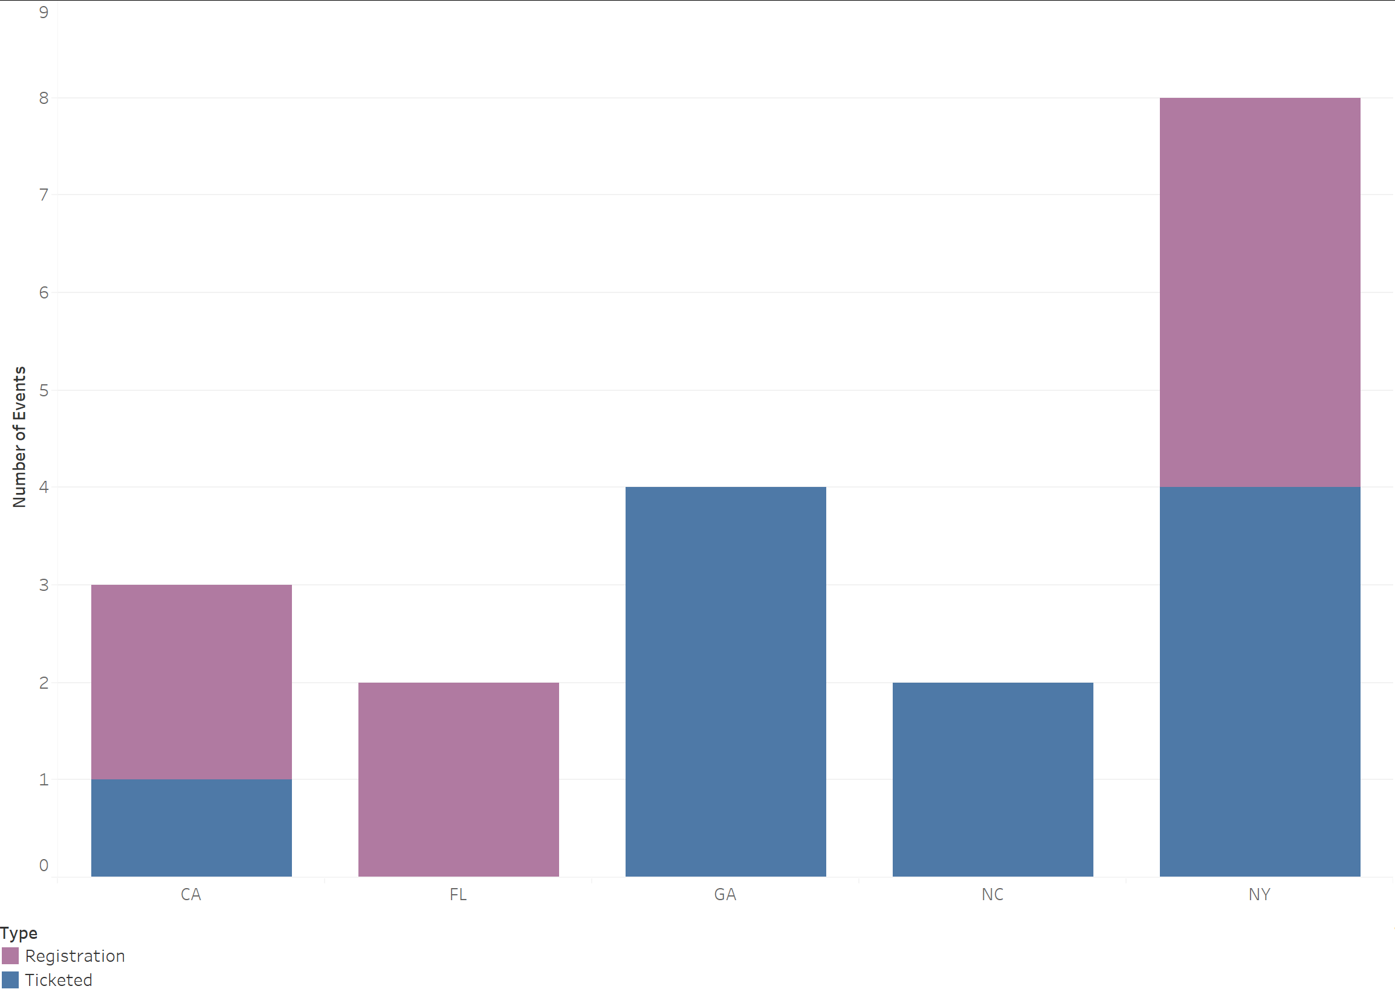
Results:
Events were not run in a variety of high non-donor states
Huge emphasis on fundraisers, which generated the least amount of revenue
We recommend increase in events across all states as donor rates are extremely low
More “Ticketed” and “Registration” based events as they generate the most revenue.
Notes:
As you can see, in terms of revenue, Fundraisers are the lowest earners however they make up the most significant portion of events held. The Ticketed and Registration events generate the most income but were run in very small numbers and not states with a large amount of potential donors. This potential revenue source is further shown by the total amounts of expected and actual revenue. Once again these events were only held in five states and in low numbers, yet accounted for almost all of the expected revenue. Additionally, there current conversion of existing members is extremely poor, they should be able to run many more events without oversaturating their membership.

